Slide 1


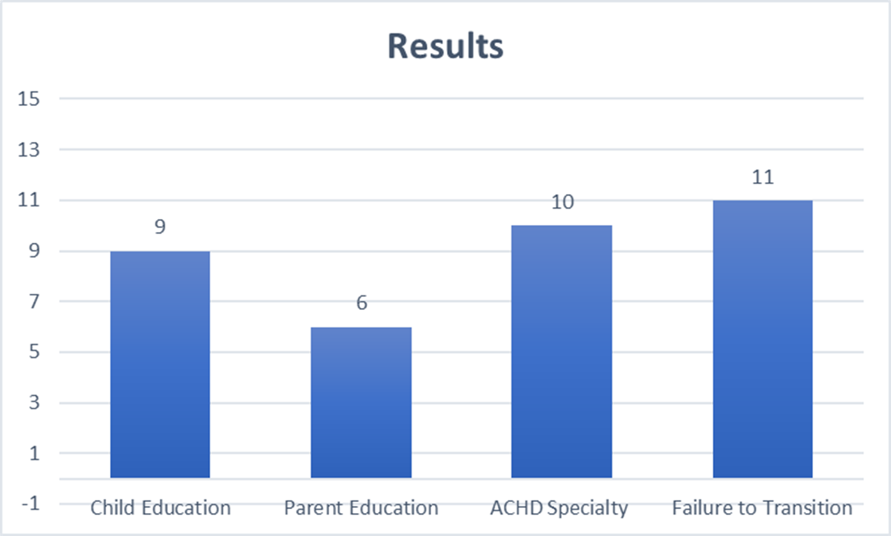
Nursing Interventions Assisting Patients with Congenital Heart Defects in the Transition from Pediatric to Adult Care
Sara Vigesaa – Calvin College, Grand Rapids, Michigan. Faculty Advisor Dr. jesse moes
Problem
Results: Main Findings
Synthesis of Evidence
:Congenital heart defects are the most common type of birth defect in the United States, resulting in approximately 1% or 40,000 children born with one each year. The Center for Disease Control and Prevention reported that currently 2.4 million people in the United States are living with a heart defect. This has created a new population of patients that require specialized care and established transition programs that move them from pediatric to adult cardiology care once adulthood is reached.
The results revealed four major findings: nursing interventions for children and parents, provider recommendations, and failure to transition.
The transition process of moving a child from a pediatric to an adult cardiologist should begin when the child is 12 or 13. It starts by teaching them more about their heart conditions and encouraging them to begin taking more responsibility in their care so that they are able to be independent by adulthood.
The transition process can be made easier for the parents by educating them years beforehand on what the process will look like and how they can help their child become more independent as they age. Parents also reported feeling more comfortable with the transition if they were able to meet the new cardiologist and tour the facility prior to the transition.
Adult congenital heart disease cardiologists are a new specialty of cardiologists that focus on adult care but have extensive knowledge about heart defects. They are more likely to cover pertinent adult education topics are recommended to take over care once a child transitions to adult cardiology.
Several studies found that between 30-50% of pediatric patients failed to follow-up with their new adult cardiologists after their transitions. This can lead to heart complications, increased emergency department visits, and increased death from heart failure.
Children with congenital heart defects are now living into adulthood and requiring adult specialized care as they age. This study showed that it is important that they are transitioning to an adult cardiologist and continuing to follow-up with care.
More research should be conducted to continue identifying barriers that keep families from transitioning to adult care and medical interventions that can be done to create a smoother transition.
Methods
A search was conducted using the databases: Web of Science, PubMed Central, Google Scholar, and Medline Plus
Search terms: nursing interventions, adult congenital heart disease, barriers in the transition from pediatric to adult care, pediatric and adult cardiologists, and adult congenital heart disease clinics
Inclusion criteria: scholarly articles in English, published within the last 5 years and contained information on one of the following subjects: knowledge level of adult and pediatric professionals, barriers in transition, adult comorbidities, nursing interventions, or follow-up visits.
Nursing Implications
Needs to be greater education for patients and parents on the importance of transitioning to an adult cardiology clinic
Begin the transition process earlier with these children
Educate the parents on the benefits of encouraging self-maintenance in their children
Need more nurses that specialize in adult congenital heart disease
Establish transition programs in pediatric clinics that pair up with adult congenital heart disease or adult cardiology clinics to help parents and children with the process
Objectives/Definitions
The purpose of this study was to investigate current studies and identify nursing interventions that can assist patients that have congenital heart defects with their transition from pediatric to adult cardiology care. Articles were examined to identity strategies that aid in a successful transition and limitations that may hinder the process.
Congenital Heart Defects: an abnormality with the structure of the heart, present at birth that disrupts blood flow to the rest of the body
Transfer- physical movement of patients from child-centered to adult-centered care
Transition- purposeful, planned process that addresses emotional needs of patients as they move from child‐centered to adult‐oriented health care
Future Research Recommendations
Need more current research on successful transition programs
Future studies looking at complications from lack of follow-up need to try and eliminate as many outside factors as possible such as age, socio-economic status, lifestyle, etc.
There need to be more studies on medical interventions to eliminate barriers that hinder the transition process
Results: Articles Included
Results: Articles by Results
References
15 articles were found that met inclusion criteria
Anton, K. (2016). Challenges caring for adults with congenital heart disease in pediatric settings: How nurses can aid in the transition. Critical Care Nurse: The Journal for High Acuity, Progressive, and Critical Care Nursing, 36(4), 1-8. doi: 10.4037/ccn2016131
Awh, K., Venuti, M. A., Gleason, L. P., Rogers, R., Denduluri, S., Kim, Y. Y. (2019). . Clinic nonattendance is associated with increased emergency department visits in adults with congenital heart disease. Congenital Heart Disease, 14(5), 726-734. Retrieved from https://doi.org/10.1111/chd.12784
Brida, M., Gatzoulis, M. A. (2019). Adult congenital heart disease: Past, present and future. Acta Paediatrica: Nurturing the Child, 108(10), 1757-1764. Retrieved from https://doi.org/10.1111/apa.14921
Chen, C., Su, W., Chiang, Y., Shu, Y., Moons, P. (2016). Healthcare needs of adolescents with congenital heart disease transitioning into adulthood: a Delphi survey of patients, parents, and healthcare providers. European Journal of Cardiovascular Nursing, 16(2), 125-135. Retrieved from https://doi.org/10.1177/1474515116643622
Chiang, Y., Chen, C., Su, W., Wang, J., Lu, C., Li, Y., Moons, P. (2014). Between invisible defects and visible impact: the life experiences of adolescents and young adults with congenital heart disease. Jan: Leading Global Nursing Research, 71(3), 599-608. Retrieved from https://doi.org/10.1111/jan.12546
Diller, G., Kempny, A., Alonso-Gonzalez, R., Swan, L., Uebing, A., Li, W…Gatzoulis, M. (2015). Survival Prospects and Circumstances of Death in Contemporary Adult Congenital Heart Disease Patients Under Follow-Up at a Large Tertiary Centre. Circulation, 132(22), 2118-2125. Retrieved from https://doi.org/10.1161/CIRCULATIONAHA.115.017202
Everitt, I., Gerardin, J. F., Rodriguez, F. H., Book, W. M. (2017). Improving the quality of transition and transfer of care in young adults with congenital heart disease. Congenital Heart Disease, 12(3), 242 250. Retrieved from https://doi.org/10.1111/chd.12463
Gerardin, J. F., Menk, J. S., Pyles, L. A., Martin, C. M., Lohr, J. L. (2015). Compliance with adult congenital heart disease guidelines: Are we following the recommendations?. Congenital Heart Disease, 11(3), 245-253. Retrieved from https://doi.org/10.1111/chd.12309
Hatchett, R., McLaren, S., Corrigan, P., Filer, L. (2019). An evaluation of a specialist nursing service for adult patients with congenital heart disease. International Journal of Nursing Practice, 21(5), 556-565. Retrieved from https://doi.org/10.1111/ijn.12300
Heery, E., Sheehan A. M., While, A. E., Coyne, I. (2015). Experiences and outcomes of transition from pediatric to adult health care services for young people with congenital heart disease: A systematic review. Congenital Heart Disease, 10(5), 413-427. Retrieved from https://doi.org/10.1111/chd.12251
Hergenroeder, A. C., Moodie, D. S., Penny, D. J., Wiemann, C. M., Sanchez‐Fournier, B., Moore, L. K., Head, J. (2018). Functional classification of heart failure before and after implementing a healthcare transition program for youth and young adults transferring from a pediatric to an adult congenital heart disease clinics. Congenital Heart Disease, 13(4), 548-553. Retrieved from https://doi.org/10.1111/chd.12604
Janssens, A., Goossens, E., Luyckx, K., Budts, W., Gewillig, M., Moons, P. (2016). Exploring the relationship between disease-related knowledge and health risk behaviours in young people with congenital heart disease. European Journal of Cardiovascular Nursing, 15(4), 231-240. Retrieved from https://doi.org/10.1177/1474515114565214
Lee, A., Bailey, B., Cullen-Dean, G., Aiello, S., Morin, J., Oechslin, E. (2017). Transition of care in congenital heart disease: Ensuring the proper handoff. Current Cardiology Reports, 19(55). Retrieved from https://doi.org/10.1007/s11886-017-0859-5
Mackie, A., Rempel, G., Kovacs, A., Kaufman, M., Rankin, K., Jelen, A…McCrindle, B. (2016). A cluster randomized trial of a transition intervention for adolescents with congenital heart disease: rationale and design of the CHAPTER 2 study. BMC Cardiovascular Disorders, 16(127). Retrieved from https://doi.org/10.1186/s12872-0160307-2
Neidenbach, R., Niwa, K., Oto, O., Oechslin, E., Aboulhosn, J., Celermajer, D…Kaemmerer, H. (2018). Improving medical care and prevention in adults with congenital heart disease reflections on a global problem—part I: Development of congenital cardiology, epidemiology, clinical aspects, heart failure, cardiac arrhythmia. Cardiovascular Diagnosis and Therapy, 8(6), 705-715. doi: 10.21037/cdt.2018.10.15

